Slide 1
COMPUTER HARDWARE SHOP MANAGEMENT (JAVA)
DEEPAK M. MANE (24025)
DARSHAN B. BHOSALE (24006)
KUNAL N. NEVKAR (24098)
SHRINIVAS D. KAMLAPURKAR (24153)
KAPIL R VARSALE (24172)

Slide 2
TABLE CONTENTS
INTRODUCTION
OBJECTIVE
TECHNOLOGY USED
EXISTING SYSTEM & REQUIREMENT FOR NEW SYSTEM
ALL DIAGRAM OF PROPOSED SYSTEM
ERD
CLASS DIAGRAM
USED CASE DIAGRAM
SEQUENCE DIAGRAM
DATABASE TABLES
PROPOSED SYSTEM
SCREENSHOTS
CONCLUSION

Slide 3
INTRODUCTION
This software enables the products acquisition of sales and return operations on stalls and shop-in-shop systems with integrated product sale software and back-office functions.
This software controls the entire lifecycle in the store through receiving, sales, inventory management.
It is about the working process of Computer store including purchase, sales, stock maintaining, manpower utilization, maintaining customer and supplier information.
The project provide computerization of the whole work, thus it help to improve the quality and productivity of the store.
The project will help store employee to maintain all related information about the purchase products, sales product, stock available in the store, supplier and customer.
This project decreases the work load of store employee and provide suitable information about each product so that with the help of this project store employee can easily and quickly find the products, supplier, customer information whenever necessary.

Slide 4
OBJECTIVES
It is very user-friendly and having added more features.
It is fully computerized and easy to access.
To develop global partnership.
Wastage of energy is avoided.
Provide security to data.
Wastage of time is avoided.
Reduce manpower.
Decrease manual mistakes.
Easy maintenance of Import and Export document.

Slide 5
Technology used
FRONT END :- JAVA
ABOUT JAVA:-
Java is a general-purpose, class-based, object-oriented programming language designed for having lesser implementation dependencies. It is a computing platform for application development. Java is fast, secure, and reliable, therefore. It is widely used for developing Java applications in laptops, data centers, game consoles, scientific supercomputers, cell phones, etc.
BACK END :- MySQL
ABOUT MySQL:-
MySQL was created by a Swedish company, MySQL AB, founded by Swedes David Axmark, Allan Larsson and Finland Swede Michael "Monty" Widenius. Original development of MySQL by Widenius and Axmark began in 1994. The first version of MySQL appeared on 23 May 1995. It was initially created for personal usage from mSQL based on the low-level language ISAM, which the creators considered too slow and inflexible. They created a new SQL interface, while keeping the same API as mSQL. By keeping the API consistent with the mSQL system, many developers were able to use MySQL instead of the (proprietarily licensed) mSQL antecedent

Slide 6
Existing system & requirement for new system
The project on “COMPUTER HARDWARE SHOP” enables to keep the records in the computer system with JAVA as Front-end and Microsoft SQL Server as Backbend.
The project keeps the detail record of Suppliers, Customers, Stock of parts, Employees of the Store.
The project provides the quotation of product to the customer which enables the customers to make his choice.
If the product not available in the store then Shopkeeper order to supplier for providing particular product which customer want.
Then related information about that ordered product stored in database of the store.
After the order given by the customer it generate the bill.

Slide 7
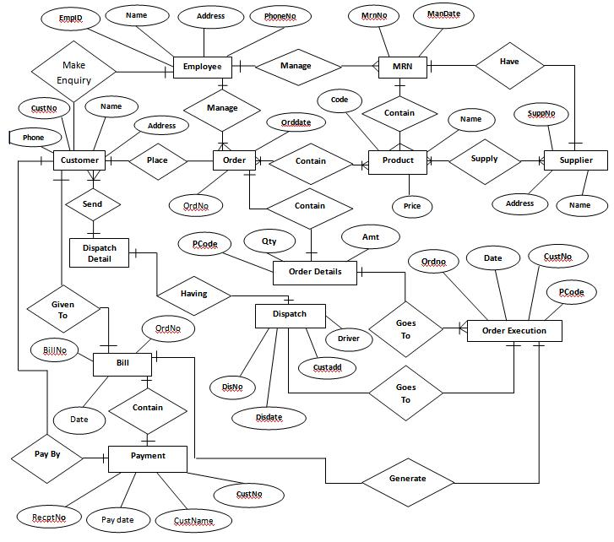
diAgram
ERD DIAGRAM

Slide 8
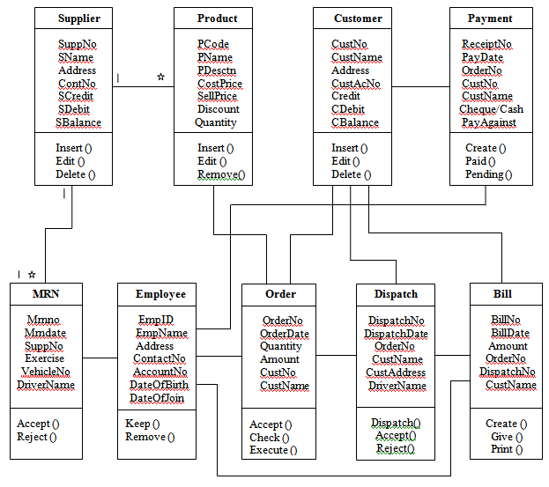
CLASS DIAGRAM

Slide 9
USED CASE DIAGRAM
Look Up Item Availability
Create /Place New Order
Validate Customer Account
Update Order
Execution of Order
Arrangement of vehicle
Dispatch the Order
Acceptance/Rejection of Order
Order
Bill Generation
Payment of Order

Slide 10
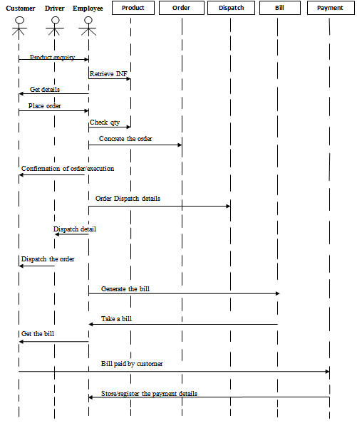
SEQUENCE DIAGRAM

Slide 11
ACTIVITY FOR LOGIN
Owner
Login
Entering User Name & Password
Verify
Wrong User Name & Password
Login Successful

Slide 12
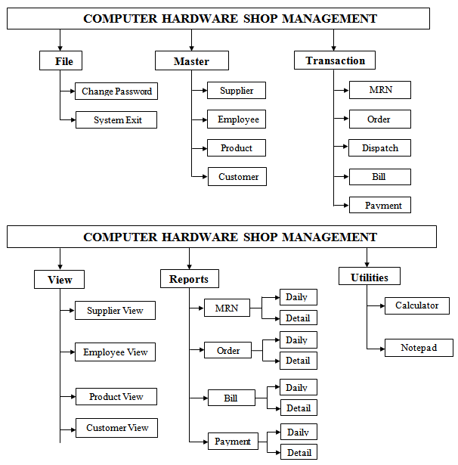
MENU TREE

Slide 13
DATABASE TABLES
Table Name: Login
Table Name: Product master
Field Name | Data Type | Description
Username | VARCHAR | It stores the Usernname
Password | VARCHAR | It stores the Password
Field Name | Data Type | Description
Product Code | VARCHAR | It stores the unique product code.
Name | VARCHAR | It stores the unique product name.
Description | VARCHAR | It stores the product description.
Cost Price | INTEGER | It stores the product cost price.
Sell Price | INTEGER | It stores the product selling price.
Discount | INTEGER | It stores the product limited discount.
Quantity | INTEGER | It stores the product quantity.
Reorder Level | INTEGER | It stores the reorder level.
Table Name: Supplier master
Field Name | Data Type | Description
Supplier INTEGER | VARCHAR | It stores the unique Supplier INTEGER.
Name | VARCHAR | It stores the unique Supplier Name.
Address | VARCHAR | It stores the unique Supplier Address.
Phone INTEGER | INTEGER | It stores the contact INTEGER of supplier.
Account INTEGER | VARCHAR | It stores the supplier bank account INTEGER.
Credit | INTEGER | It stores the supplier credit details.
Debit | INTEGER | It stores the supplier debit details.
Balance | INTEGER | It stores the supplier balance details.
Table Name: Customer master
Field Name | Data Type | Description
Customer INTEGER | VARCHAR | It stores the unique customer INTEGER.
Name | VARCHAR | It stores the unique customer Name.
Address | VARCHAR | It stores the unique customer Address.
Phone INTEGER | INTEGER | It stores the contact INTEGER of customer.
Account INTEGER | VARCHAR | It stores customer bank account INTEGER.
Credit | INTEGER | It stores the customer credit details.
Debit | INTEGER | It stores the customer debit details.
Balance | INTEGER | It stores the customer balance details.
Table Name: Employee master
Field Name | Data Type | Description
Employee ID | VARCHAR | It stores the unique employee INTEGER.
Name | VARCHAR | It stores the unique employee Name.
Address | VARCHAR | It stores the unique employee Address.
Phone INTEGER | INTEGER | It stores the contact INTEGER of employee
Date of Birth | DATETIME | It stores the date of birth of an employee.
Date of Join | DATETIME | It stores the date of joining of an employee.
Email ID | VARCHAR | It stores the Email-id of employee.
Salary | INTEGER | It stores the salary of employee.

Slide 14
Table Name: MRN master
Table Name: Dispatch Master
Field Name | Data Type | Description
MRN INTEGER | VARCHAR | It stores the unique MRN INTEGER.
Date | DATETIME | It stores the date.
Supplier INTEGER | VARCHAR | It retrieve the supplier INTEGER.
Product Excise | VARCHAR | It stores product excise code.
Vehicle INTEGER | VARCHAR | It stores the vehicle INTEGER.
Driver Name | VARCHAR | It stores the driver name.
Field Name | Data Type | Description
Dispatch INTEGER | VARCHAR | It stores the unique dispatch INTEGER.
Dispatch Date | DATETIME | It stores the dispatch date.
Customer INTEGER | VARCHAR | It retrieve the customer INTEGER.
Customer Address | VARCHAR | It retrieve the customer Name.
Order INTEGER | VARCHAR | It retrieve order INTEGER.
Vehicle INTEGER | VARCHAR | It stores the vehicle INTEGER.
Driver Name | VARCHAR | It stores the driver name.
Table Name: MRN Transaction
Field Name | Data Type | Description
MRN INTEGER | VARCHAR | It stores the unique MRN INTEGER.
Product Code | VARCHAR | It retrieve the product code.
Quantity | INTEGER | It stores the product quantity.
Received Quantity | INTEGER | It stores the product received quantity.
Rejected Quantity | INTEGER | It stores the product rejected quantity.
Product Rate | INTEGER | It stores the single product rate.
Product Amount | INTEGER | It stores the total product amount.
Table Name: Dispatch Transaction
Field Name | Data Type | Description
Dispatch INTEGER | VARCHAR | It stores the unique dispatch INTEGER.
Product Code | VARCHAR | It retrive the product code.
Product Quantity | INTEGER | It stores the product quantity.
Received Quantity | INTEGER | It stores the product received quantity.
Rejected Quantity | INTEGER | It stores the product rejected quantity.
Product Rate | INTEGER | It stores the product rate.
Table Name: Order master
Table Name: Bill Master
Field Name | Data Type | Description
Order INTEGER | VARCHAR | It stores the unique order INTEGER.
Order Date | DATETIME | It stores the order date.
Customer INTEGER | VARCHAR | It retrieve the customer INTEGER.
Customer Name | VARCHAR | It retrieve the customer Name.
Field Name | Data Type | Description
Bill INTEGER | VARCHAR | It stores the unique bill INTEGER.
Bill Date | DATETIME | It stores the bill genrate date.
Customer INTEGER | VARCHAR | It retrieve the customer INTEGER.
Customer Name | VARCHAR | It stores the customer name.
Order INTEGER | VARCHAR | It retrieve the order nuber.
Dispatch INTEGER | VARCHAR | It retrieve the dispatch INTEGER.
Table Name: Order Transaction
Field Name | Data Type | Description
Order INTEGER | VARCHAR | It retrieve order INTEGER.
Product Code | VARCHAR | It retrieve the product code.
Product Name | INTEGER | It stores the product name.
Product Description | INTEGER | It stores the product description.
Product Quantity | INTEGER | It stores the product quantity.
Product Rate | INTEGER | It stores the single product rate.
Order Billed | Yes/No | It stores record from order.

Slide 15
Table Name: Bill Transaction
Field Name | Data Type | Description
Bill INTEGER | VARCHAR | It stores the unique bill INTEGER.
Product Code | VARCHAR | It retrieve the product code.
Product Description | INTEGER | It stores the product description.
Received Quantity | INTEGER | It stores the product received quantity.
Product Rate | INTEGER | It stores the product rate.
Product Discount | INTEGER | It stores the product limited discount.
Product Amount | INTEGER | It stores the total product amount.
Table Name: Product Amount
Field Name | Data Type | Description
Bill INTEGER | VARCHAR | It stores the unique bill INTEGER.
Bill Date | DATETIME | It stores the bill genrate date.
Customer INTEGER | VARCHAR | It retrieve the customer INTEGER.
Order INTEGER | VARCHAR | It retrieve the order nuber.
Dispatch INTEGER | VARCHAR | It retrieve the dispatch INTEGER.
Product Amount | INTEGER | It stores the total product amount.
Table Name: Payment Receipt
Field Name | Data Type | Description
Receipt INTEGER | VARCHAR | It stores the unique receipt INTEGER.
Payment Date | DATETIME | It stores the payment genrate date.
Customer INTEGER | VARCHAR | It retrieve the customer INTEGER.
Customer Name | VARCHAR | It stores the customer name.
Payment Against | VARCHAR | It check the payment against.
Bill Amount | INTEGER | It retrieve the payment bill amount.
Payment Mode | VARCHAR | It’s type of payment mode.
Cheque INTEGER | INTEGER | It stores the checque INTEGER.
Bank Name | VARCHAR | It stores the bank name.
Cheque Amount | INTEGER | It stores the cheque amount.

Slide 16
Proposed system
The proposed system that we are making will be completely different and more importantly it will be user friendly.
It can be operated by anyone. It comes with some up-to-date functions which you can perform by just clicking a mouse button.
The aim of this system is to advance to the next level by making everything computerized. It has advantages like this:
It’s user-friendly and it’s completely computerized.
It has a huge data base which can store lots and lots of information.
Data can be easily entered, updated. I.e. data can be managed easily.
No need to worry about the storage of the data as it will be stored in your computer.
Search results can be shown to the clients at the same place and proper and correct information can be provided.

Slide 17
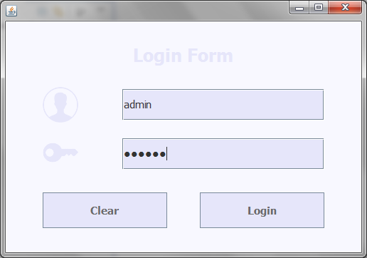
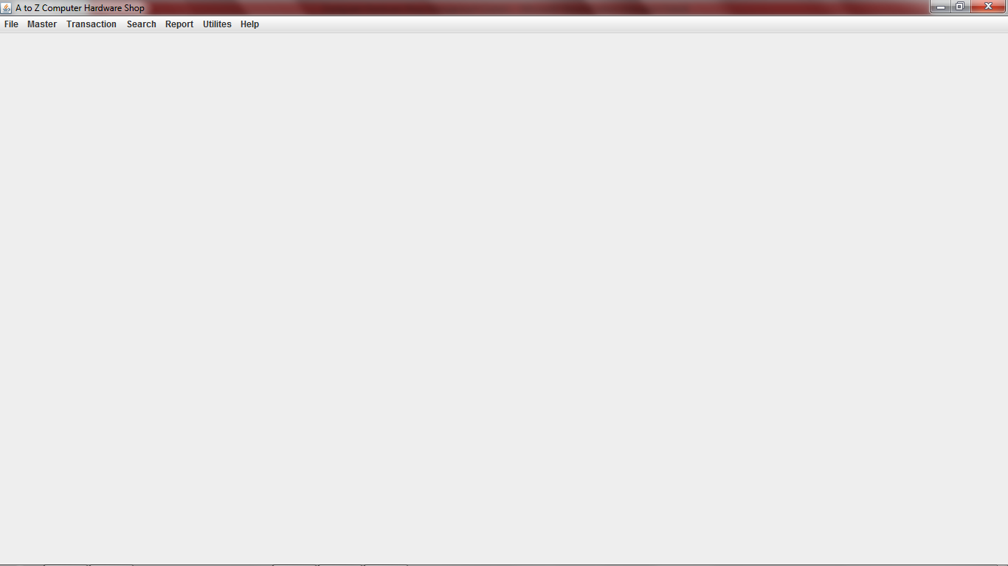
Screenshots
Login.java
Menuscreen.java

Slide 18
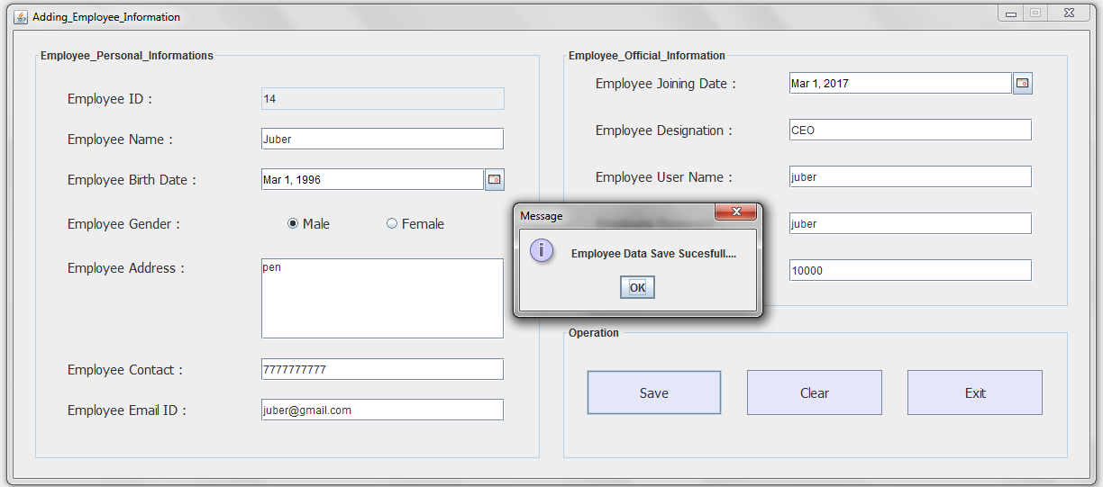
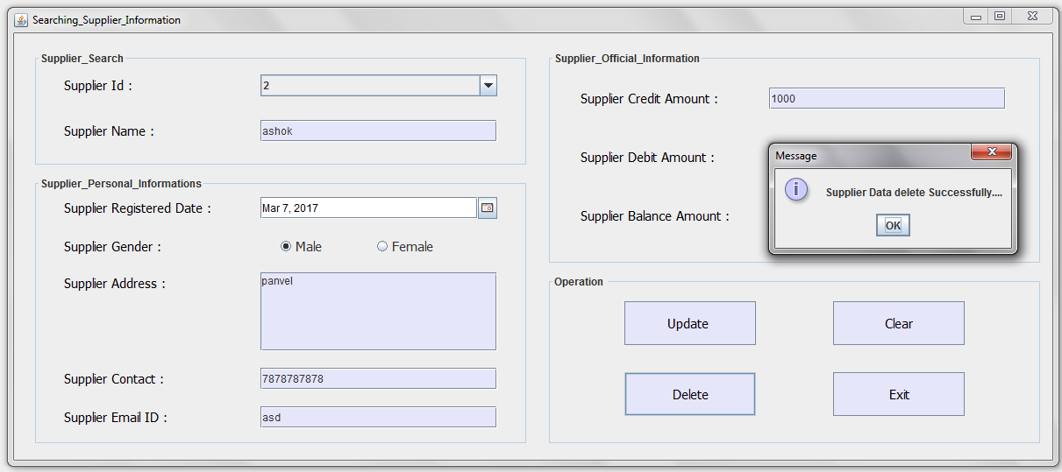
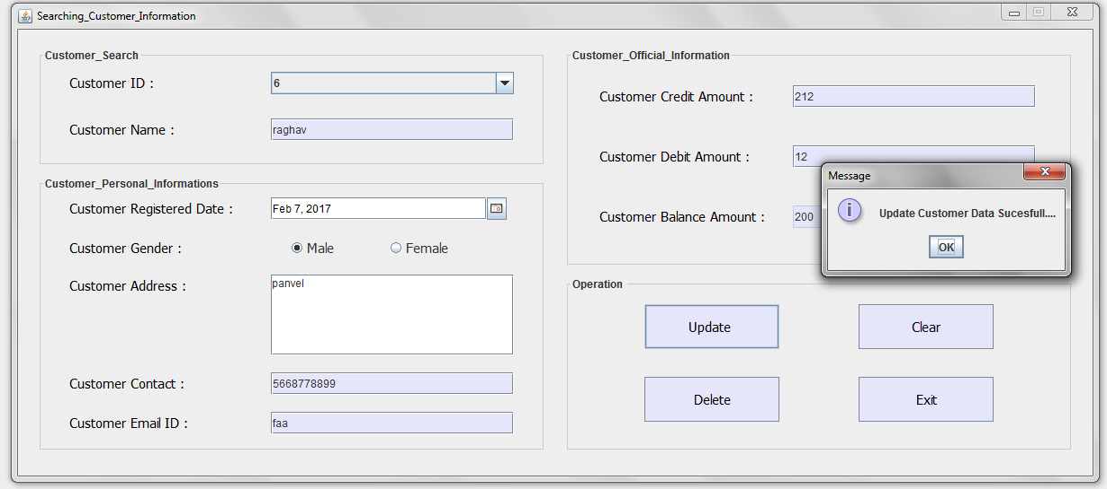
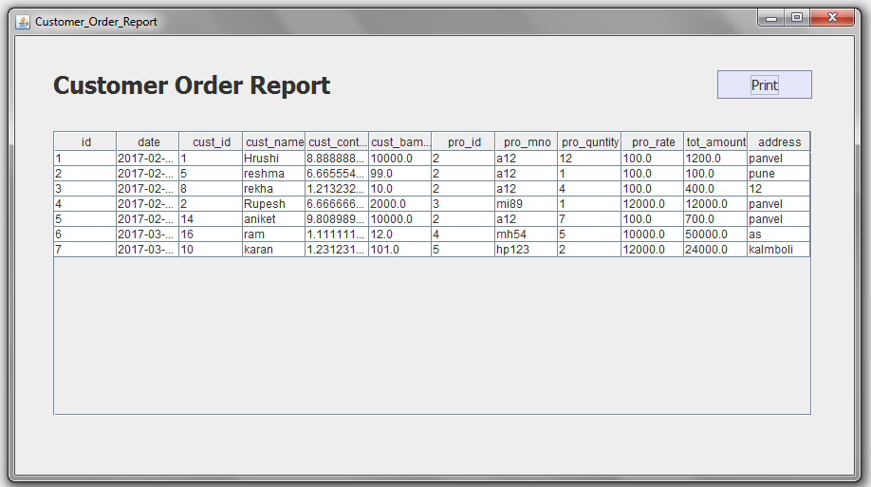
AddEmployee.java
ModifySupplier.java
ModifyCustomer.java
View Customer Order Report

Slide 19
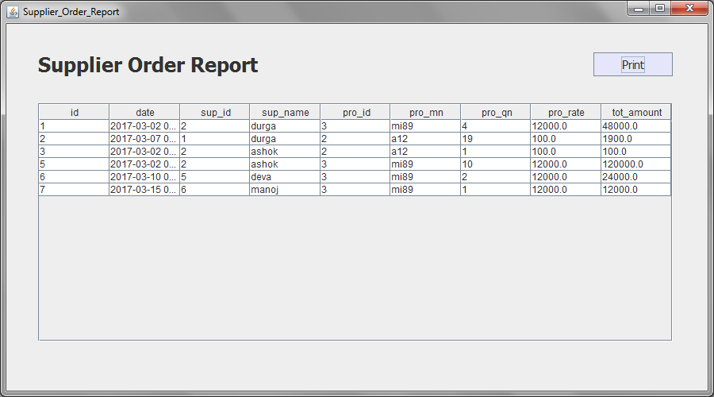
RPDSuppOrder.java

Slide 20
ADVANTAGES
It’s user-friendly and it’s completely computerized.
It has a huge data base which can store lots and lots of information.
Data can be easily entered, updated. I.e. data can be managed easily.
No need to worry about the storage of the data as it will be stored in your computer.
Search results can be shown to the clients at the same place and proper and correct information can be provided.

Slide 21
CONCLUSION
A description of the background and context of the project and its relation to work already done in the area.
Made statement of the aims and objectives of the project.
The description of Purpose, Scope, and applicability.
We define the problem on which we are working in the project.
We describe the requirement Specifications of the system and the actions that can be done these things.
We understand the problem domain and produce a model of the system, which describes operations that can be performed on the system.
We included features and operations in detail, including screen layouts.
We designed user interface and security issues related to system.
Finally the system is implemented and tested according to test cases.

